Slide 1

MLB:
Quantifying the Workload of a Starting Pitcher
Jacob Wheat
Sports Analytics
Professor Drewry and Professor Fanning
February 26, 2025

Slide 2
Agenda
What is Player Value?
Key Statistics
zWAR
Players
Conclusion
Topics of Interest

Slide 3
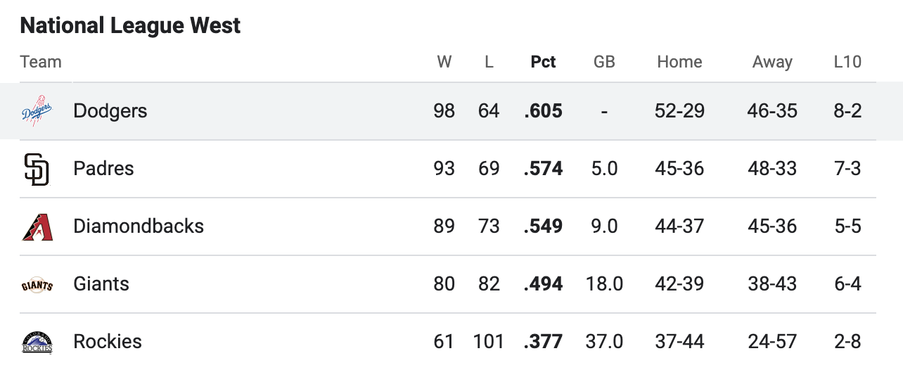
What is Player Value?
Wins Above Replacement (WAR) measures how valuable a player is to their club compared to an average replacement.
Team | 2024 Record w/ Ohtani | 2024 Record w/out Ohtani
Los Angeles Dodgers | 98-64 | 91-73
Ohtani 2024 fWAR: | 9.1
MLB Average fWAR: | 2.0
*Fangraphs

Slide 4
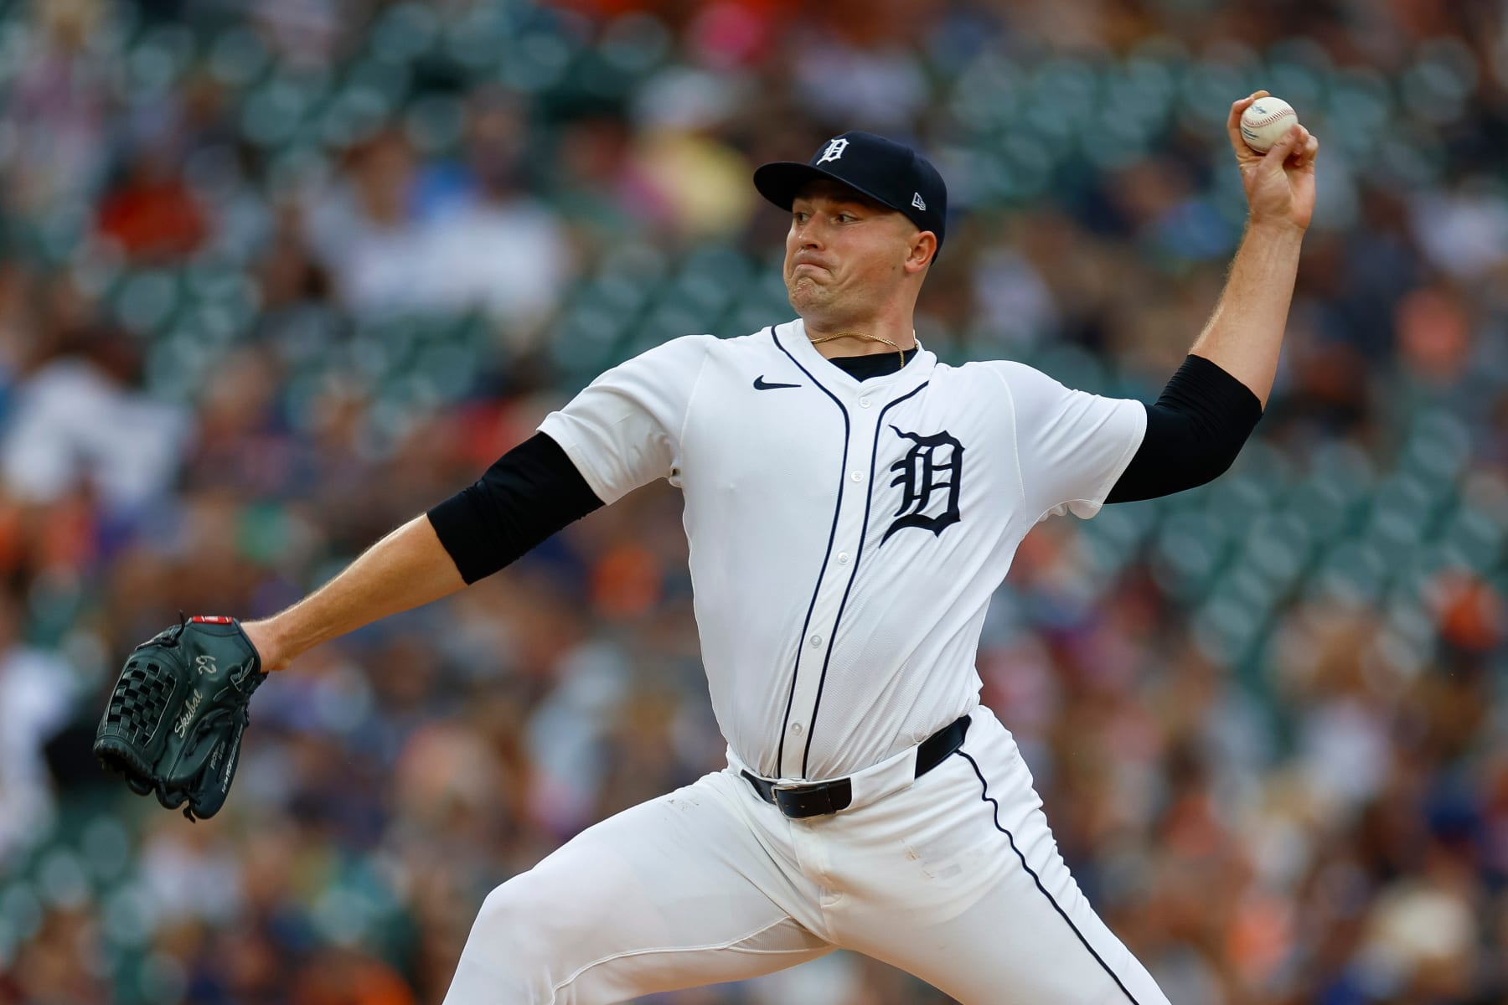
Why Does it Matter?
Winning is the most important objective in baseball.
WAR can help determine:
Making the playoffs
Factors how much the player gets paid
Tarik Skubal | Detroit Tigers | 2024 AL Cy Young Winner

Slide 5
Key Statistics

Slide 6
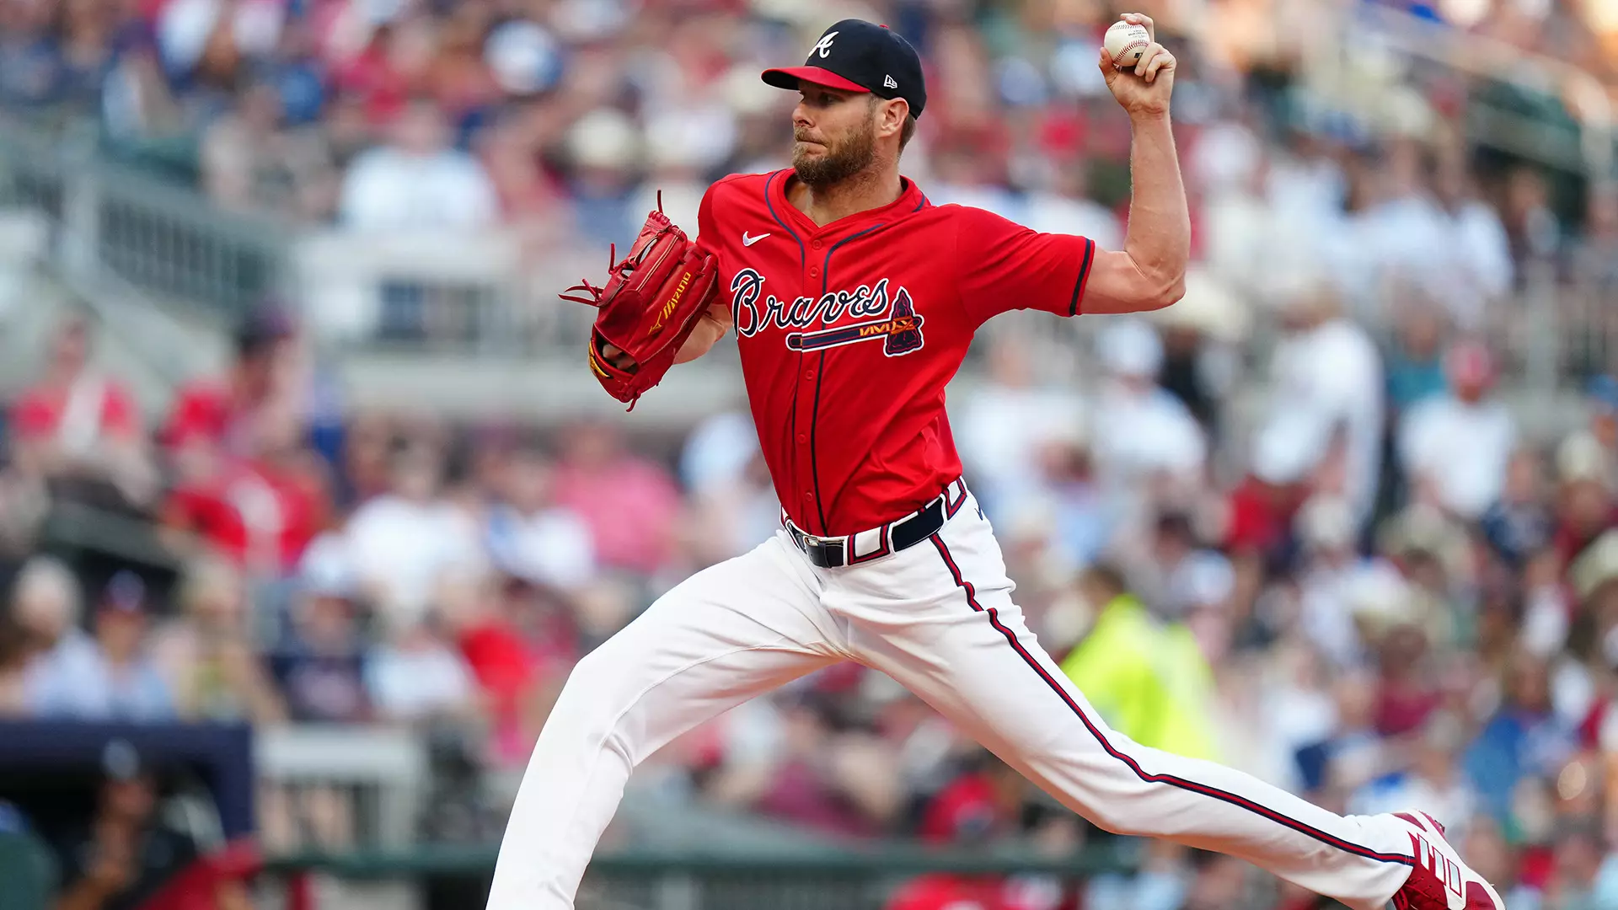
Total Batters Faced (TBF)
How many batters the pitcher faced
Workload
Chris Sale | Atlanta Braves | 2024 NL Cy Young Winner

Slide 7
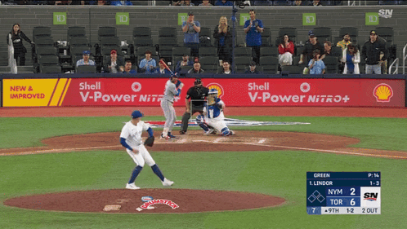
Strikeout (K)
The pitcher throws any combination of strike three swinging or looking to the opposing batter.

Slide 8
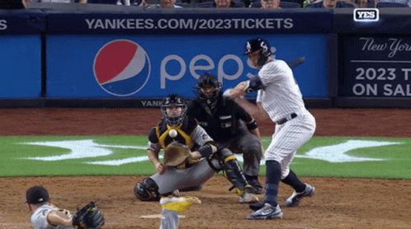
Home Run (HR)
When a batter hits the ball, rounds all of the bases, and scores at home plate in one play.

Slide 9
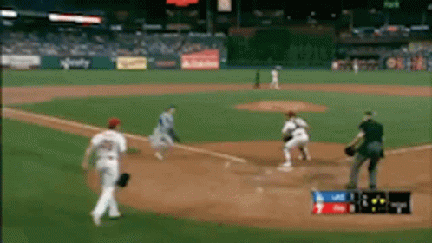
Earned Run (ER)
Any base runner that reaches home plate against the pitcher that allowed them to reach base initially negating errors.

Slide 10
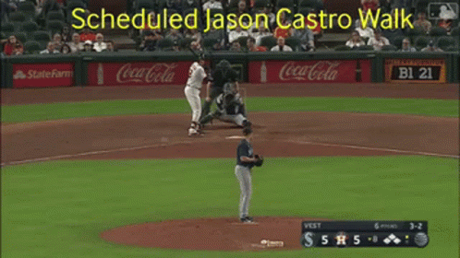
Walk (Base on Balls/BB)
When a pitcher throws four pitches outside of the strike zone to the same batter granting a free base.

Slide 11
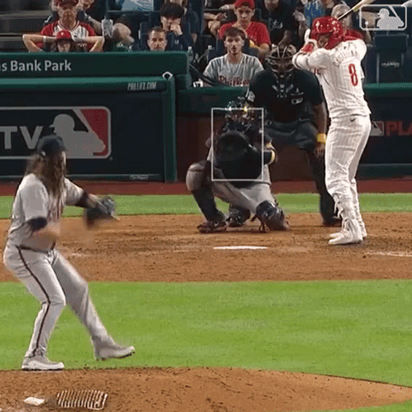
Hits (H)
When the batter hits the ball into fair territory and reaches at least one base without any errors or fielder’s choice.

Slide 12
Statistical Summary
Statistic | Abbreviation | Definition
Total Batters Faced | TBF | Number of batters the pitcher faced in a given situation. Measurement of workload.
Strikeout | K | The pitcher throws any combination of strike three swinging or looking to the opposing batter.
Home Run | HR | When a batter rounds all of the bases and scores at home plate in one play.
Earned Run | ER | Any run that is scored against the pitcher negating any errors on how they got on base.
Walk | BB | When a pitcher throws four pitches outside of the strike zone granting the batter a free base.
Hit | H | When the batter hits a ball into fair territory without any errors or fielder’s choice.

Slide 13
zWAR

Slide 14
zWAR
Innovative baseball metric measures the quality of a starting pitcher’s workload while taking into account the factors they can control:
TBF, K, HR, ER, BB, H
Rewards pitcher for having a high volume workload (TBF) and strikeouts (K)
Penalizes pitcher for allowing Home Runs (HR), Earned Runs (ER), Walks (BB), and Hits (H)
Formula:
(0.5TBF + 1.5K) - (5HR + 3ER + 1.5BB + 0.5H)
100

Slide 15

Players

Slide 16
2024 Cy Young Results (MLB.com)
American League (AL)
National League (NL)
Cy Young Place | Player | Team
1 | Tarik Skubal | Detroit Tigers
2 | Seth Lugo | Kansas City Royals
3 | *Emmanuel Clase | Cleveland Guardians
4 | Cole Ragans | Kansas City Royals
5 | Corbin Burnes | Baltimore Orioles
6 | Logan Gilbert | Seattle Mariners
Cy Young Place | Player | Team
1 | Chris Sale | Atlanta Braves
2 | Zack Wheeler | Philadelphia Phillies
3 | Paul Skenes | Pittsburgh Pirates
4 | Dylan Cease | San Diego Padres
5 | Shota Imanaga | Chicago Cubs
*Emmanuel Clase - Closer/Relief Pitcher

Slide 17
2024 Data (Fangraphs)
American League
National League
Cy Place | Player | TBF | K | HR | ER | BB | H
1 | Tarik Skubal | 753 | 228 | 15 | 51 | 35 | 142
2 | Seth Lugo | 836 | 181 | 16 | 69 | 48 | 177
3 | Emmanuel Clase | 270 | 66 | 2 | 5 | 10 | 39
4 | Cole Ragans | 762 | 223 | 15 | 65 | 67 | 146
5 | Corbin Burnes | 784 | 181 | 22 | 63 | 48 | 165
6 | Logan Gilbert | 803 | 220 | 26 | 75 | 37 | 148
Cy Place | Player | TBF | K | HR | ER | BB | H
1 | Chris Sale | 702 | 225 | 9 | 47 | 39 | 141
2 | Zack Wheeler | 787 | 224 | 20 | 57 | 52 | 139
3 | Paul Skenes | 514 | 170 | 10 | 29 | 32 | 94
4 | Dylan Cease | 762 | 224 | 18 | 73 | 65 | 137
5 | Shota Imanaga | 694 | 174 | 27 | 56 | 28 | 149

Slide 18
2024 zWAR
American League
National League
Cy Place | Player | zWAR
1 | Tarik Skubal | 3.67
2 | Seth Lugo | 2.42
3 | Emmanuel Clase | 1.75
4 | Cole Ragans | 2.72
5 | Corbin Burnes | 2.10
6 | Logan Gilbert | 2.47
Cy Place | Player | zWAR
1 | Chris Sale | 3.73
2 | Zack Wheeler | 3.11
3 | Paul Skenes | 2.80
4 | Dylan Cease | 2.42
5 | Shota Imanaga | 1.88

Slide 19
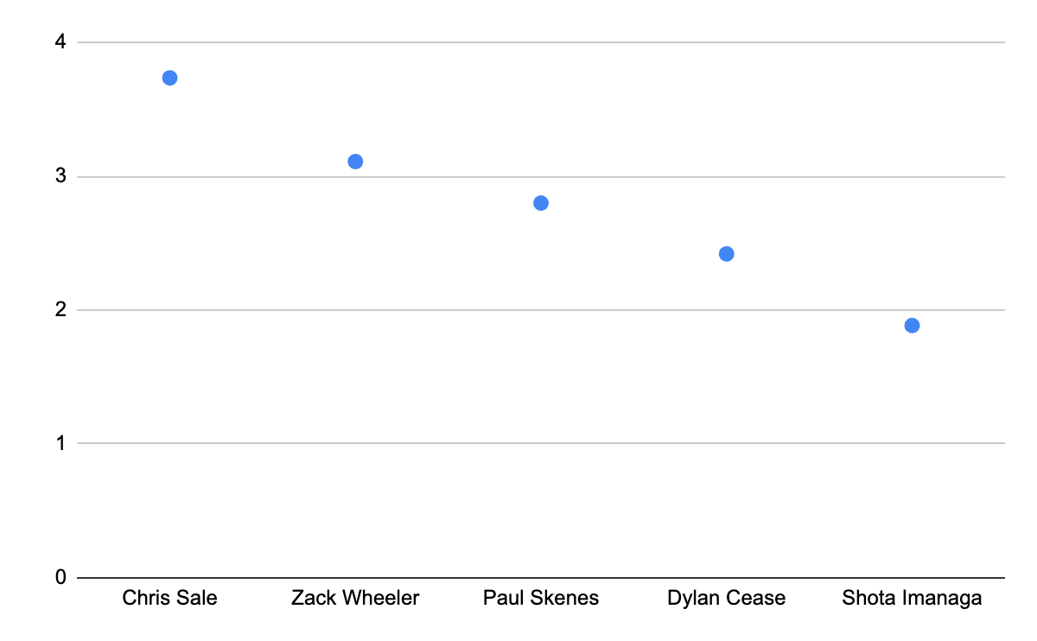
2024 National League zWAR
Cy Place | Player | zWAR
1 | Chris Sale | 3.73
2 | Zack Wheeler | 3.11
3 | Paul Skenes | 2.80
4 | Dylan Cease | 2.42
5 | Shota Imanaga | 1.88
zWAR
Player

Slide 20
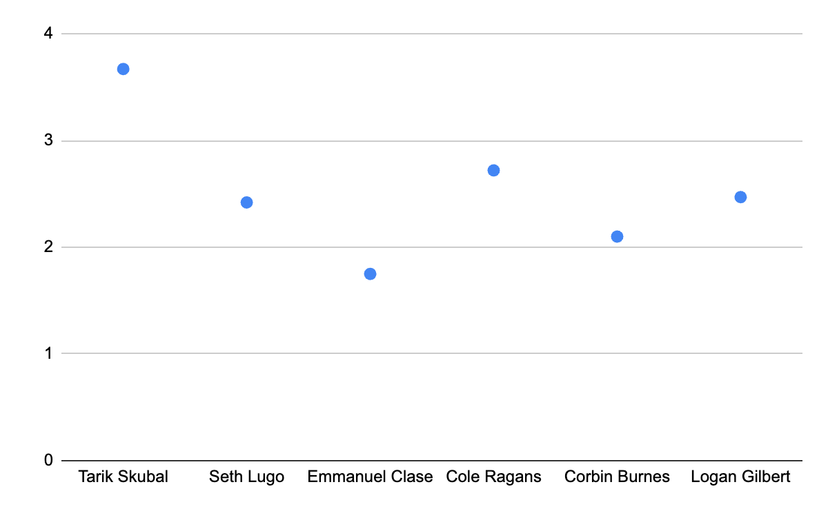
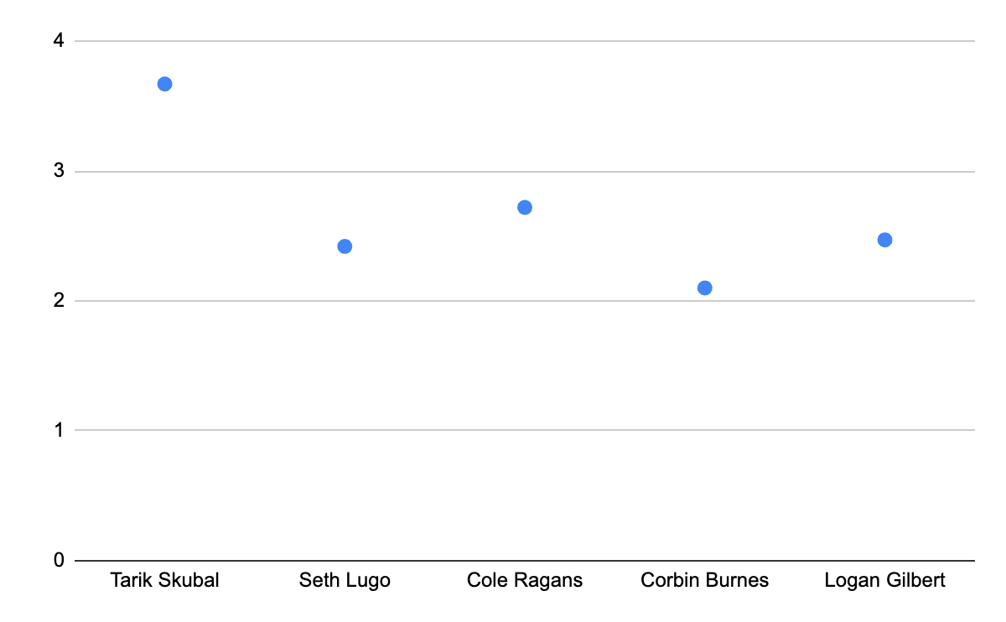
2024 American League zWAR Incl. Clase
2024 American League zWAR Excl.Clase
zWAR
zWAR
Player
Player
Cy Place | Player | zWAR
1 | Tarik Skubal | 3.67
2 | Seth Lugo | 2.42
3 | Emmanuel Clase | 1.75
4 | Cole Ragans | 2.72
5 | Corbin Burnes | 2.10
6 | Logan Gilbert | 2.47

Slide 21
2024 zWAR Summary
National League
American League Incl. Clase
zWAR
zWAR
Player
Player
Cy Place | Player | zWAR
1 | Tarik Skubal | 3.67
2 | Seth Lugo | 2.42
3 | Emmanuel Clase | 1.75
4 | Cole Ragans | 2.72
5 | Corbin Burnes | 2.10
6 | Logan Gilbert | 2.47
Cy Place | Player | zWAR
1 | Chris Sale | 3.73
2 | Zack Wheeler | 3.11
3 | Paul Skenes | 2.80
4 | Dylan Cease | 2.42
5 | Shota Imanaga | 1.88

Slide 22
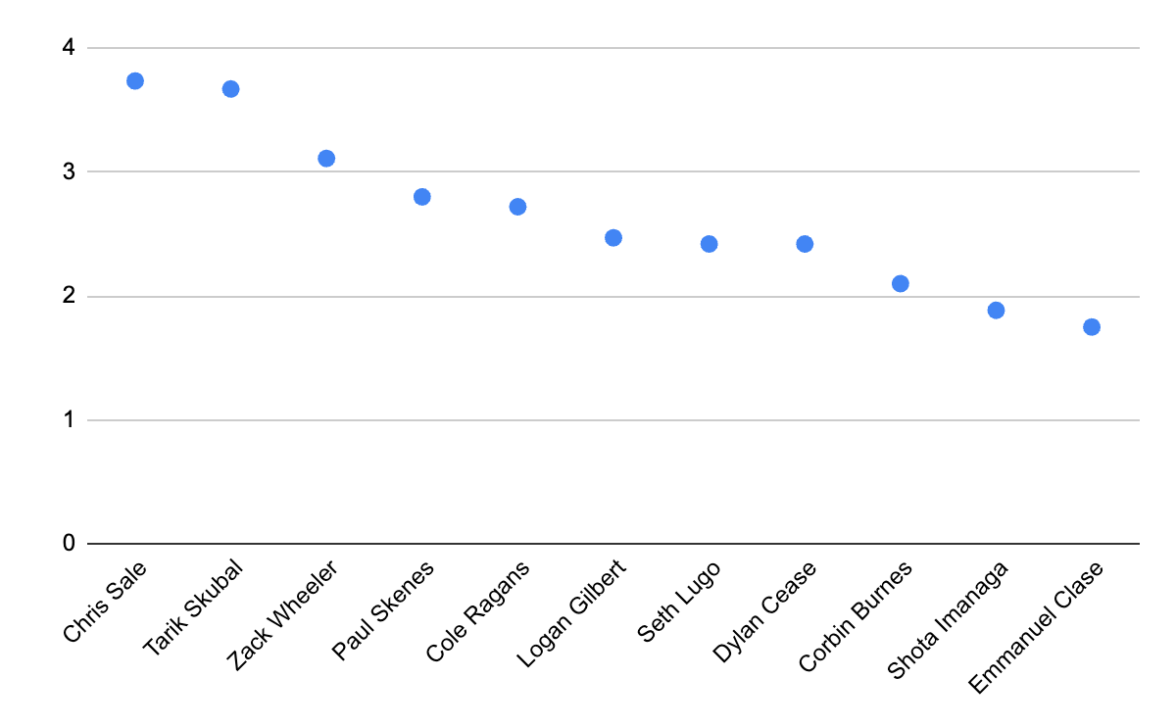
2024 zWAR Compiled Summary
CY Place | Player | zWAR
NL 1 | Chris Sale | 3.73
AL 1 | Tarik Skubal | 3.67
NL 2 | Zack Wheeler | 3.11
NL 3 | Paul Skenes | 2.80
AL 4 | Cole Ragans | 2.72
AL 6 | Logan Gilbert | 2.47
AL 2 | Seth Lugo | 2.42
NL 4 | Dylan Cease | 2.42
AL 5 | Corbin Burnes | 2.10
NL 5 | Shota Omanaga | 1.88
AL 3 | Emmanuel Clase | 1.75
zWAR
Player

Slide 23
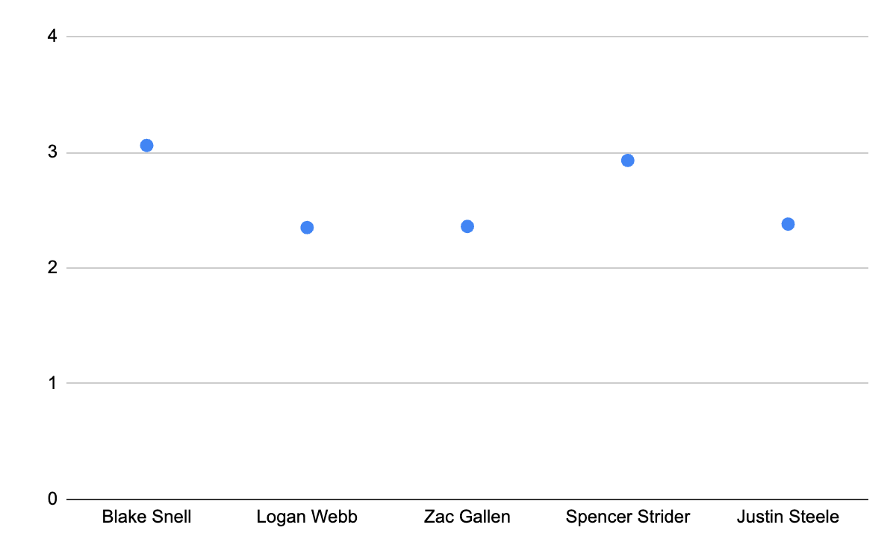
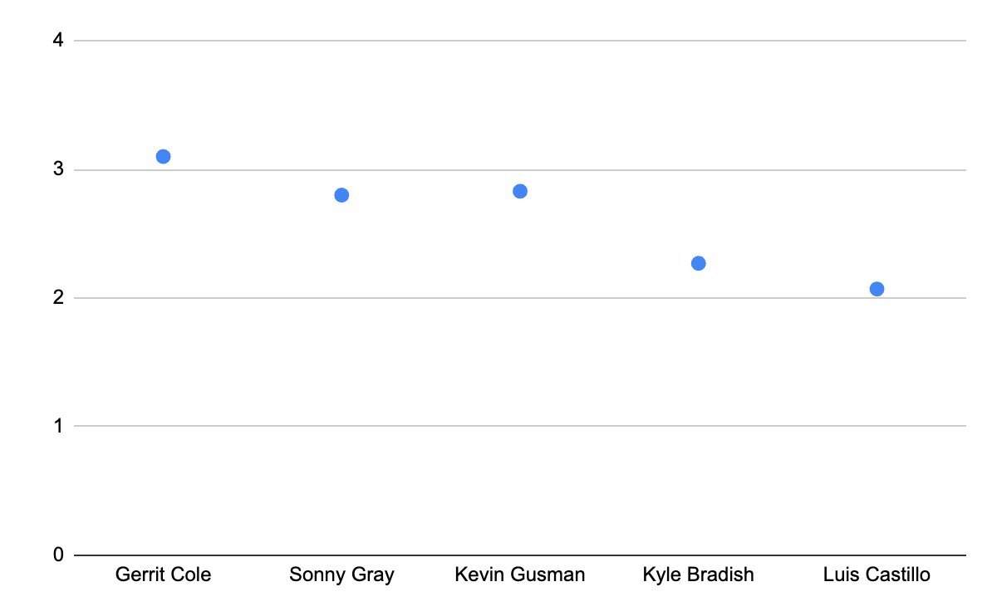
2023 Cy Young Results
National League
American League
zWAR
zWAR
Player
Player
Cy Place | Player | zWAR
1 | Blake Snell | 3.06
2 | Logan Webb | 2.35
3 | Zac Gallen | 2.36
4 | Spencer Strider | 2.93
5 | Justin Steele | 2.38
Cy Place | Player | zWAR
1 | Gerrit Cole | 3.10
2 | Sonny Gray | 2.80
3 | Kevin Gausman | 2.83
4 | Kyle Bradish | 2.27
5 | Luis Castillo | 2.07

Slide 24
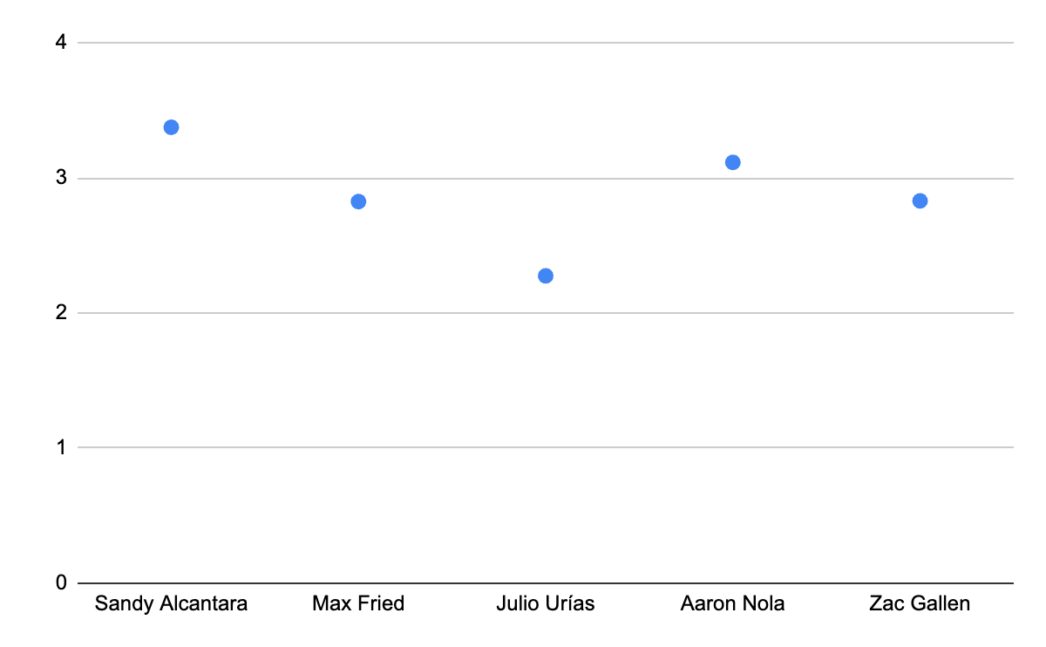
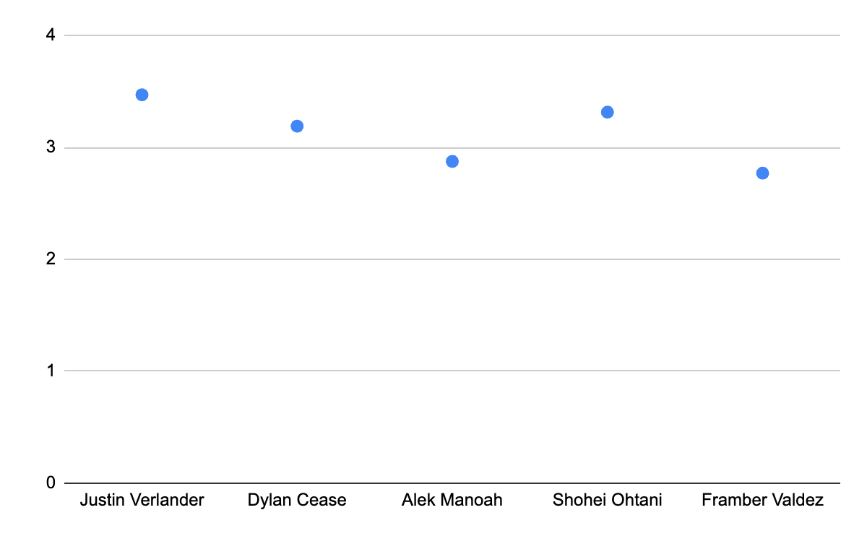
2022 Cy Young Results
National League
American League
zWAR
zWAR
Player
Player
Cy Place | Player | zWAR
1 | Sandy Alcantara | 3.38
2 | Max Fried | 2.83
3 | Julio Urías | 2.28
4 | Aaron Nola | 3.12
5 | Zac Gallen | 2.83
Cy Place | Player | zWAR
1 | Justin Verlander | 3.47
2 | Dylan Cease | 3.19
3 | Alek Manoah | 2.88
4 | Shohei Ohtani | 3.32
5 | Framber Valdez | 2.77

Slide 25
Previous Cy Young Winners
National League
American League
Year | Player | zWAR
2024 | Chris Sale | 3.73
2023 | Blake Snell | 3.06
2022 | Sandy Alcantara | 3.38
2021 | Corbin Burnes | 3.97
2020* | Trevor Bauer | 3.37
2019 | Jacob deGrom | 3.82
2018 | Jacob deGrom | 5.03
2017 | Max Scherzer | 3.69
2016 | Max Scherzer | 3.31
2015 | Jake Arrieta | 4.57
2014 | Clayton Kershaw | 4.55
Year | Player | zWAR
2024 | Tarik Skubal | 3.67
2023 | Gerrit Cole | 3.10
2022 | Justin Verlander | 3.47
2021 | Robbie Ray | 2.58
2020* | Shane Bieber | 3.78
2019 | Justin Verlander | 3.70
2018 | Blake Snell | 3.36
2017 | Corey Kluber | 4.04
2016 | Rick Porcello | 2.35
2015 | Dallas Keuchel | 3.33
2014 | Corey Kluber | 4.37
*extrapolated statistics from COVID

Slide 26
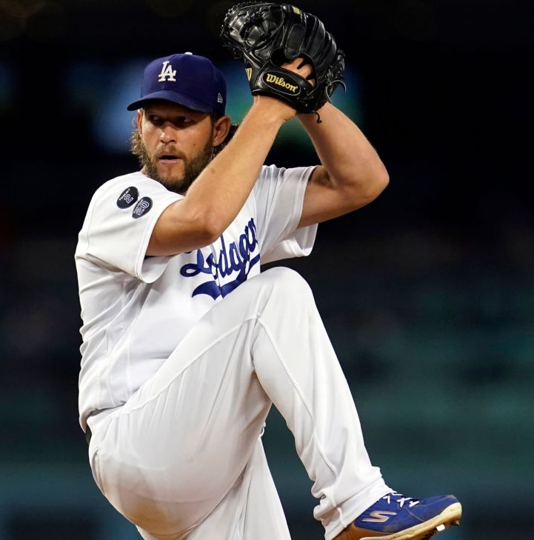
Conclusion
zWAR has potential
Positives:
Correlation for 2024 NL
Cy Young winners = highest zWAR
Negative:
Inconsistencies for 2nd-5th Place Finishers
Further Implications:
Add other possible metrics, modify included metrics, and increase sample size
Clayton Kershaw | Los Angeles Dodgers 3x NL Cy Young Winner

Slide 27
Other Topics of Interest…
Pitch selection
Pitch count
Left/right handed hitter
Left/right handed pitcher
Certain pitches not working?
How many outs are there?
Baserunner situation
Quality of opponent
Ballpark Dimensions (Coors Field v. T-Mobile Park)
Opposing hitter’s tendencies
Pitcher’s tendencies
Within 3 runs (save situation) or blowout (5+ runs)
Early, mid, or late game?
Spring Training v. Regular Season v. Postseason
Compare Clase to other Closers in MLB

Slide 28
Thank You!

Slide 29
References
https://www.fangraphs.com/
https://www.mlb.com/awards/cy-young
https://www.mlb.com/news/2022-mlb-cy-young-award-voting-results
https://www.mlb.com/news/2023-mlb-cy-young-award-voting-results
https://www.mlb.com/news/mlb-cy-young-award-winners-2024
https://www.mlb.com/glossary/advanced-stats/wins-above-replacement

